Slide 1
O-CNv2 Model — TRENDY
CMIP6 Working Group
Song Wang
Wangs.18b@igsnrr.ac.cn

Slide 2
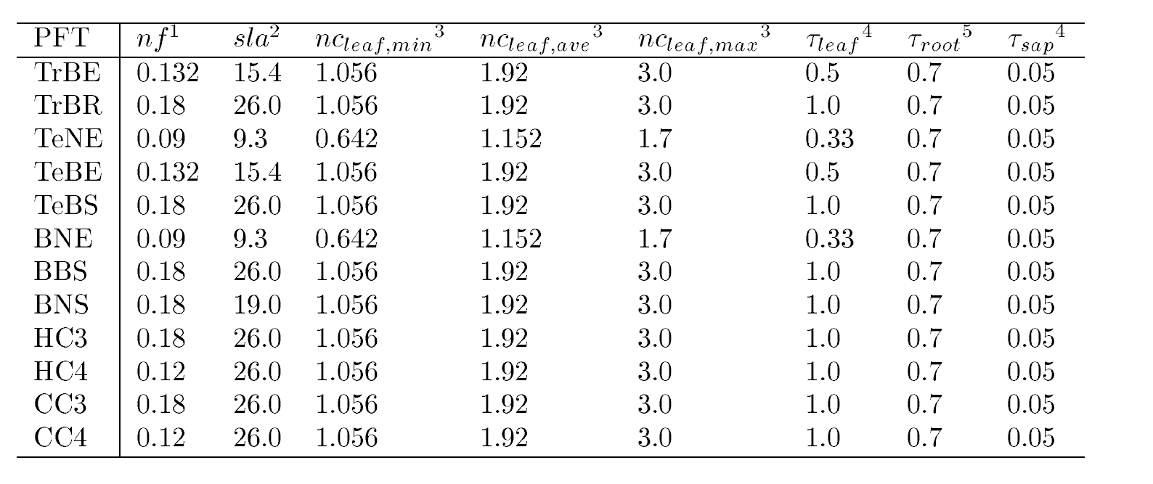
Model: O-CN
2.Lead PI :OCN Sönke Zaehle, szaehle@bgc-jena.mpg.de
3.Static vegetation:
4.Number of plant functional types:12
Tropical broadleaved evergreen,
Tropical broadleaved rain green,
Temperate needleleaved evergreen,
Temperate broadleaved evergreen,
Temperate broadleaved summergreen,
Boreal needleleaved evergreen,
Boreal broadleaved summergreen,
Boreal needleleaved summergreen,
C3 herbaceous,
C4 herbaceous,
C3 crops,
C4 crops.
(ZAEHLE AND FRIEND. 2010)

Slide 3
4.Disturbence: No
5.Number of pools
POOL TYPE | vegetation biomass pools | litter pools | soil organic matter pools | soil mineral N pools | Other N-related pools
NUMBER | 9 | 6 | 4 | 2 | 4
DETIAL | foliage, fine roots, aboveground and belowground sapwood and heartwood, fruit organs, short-term (labile) and long-term storage | aboveground and belowground metabolic, structural, and woody litter | differing decomposability | ammonium and nitrate | NH3, NOx, N2O, and N2
N uptake
N input
Photosynthesis
ER
ammonium
labile
soil mineral N
RA
nitrate
aboveground
sapwood
heartwood
foliage
fine roots
long-term storage
belowground
sapwood
heartwood
RH
N mineralization
Biomass
fruit organs
NH3, NOx, N2O, and N2
aboveground
woody
structural
metabolic
Surface
Litter
belowground
woody
structural
metabolic
Active
Slow
Passive
Not very sure, it comes from the understanding of model description

Slide 4
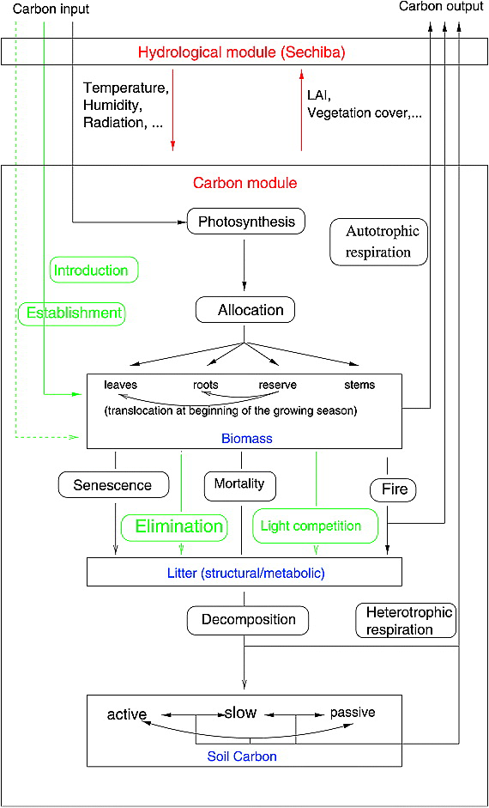
7.How are pools connected? (i.e., carbon flow diagram)
Basic structure of ORCHIDEE (Krinner et al.,2005)
(Zaehle and Friend, 2010)

Slide 5
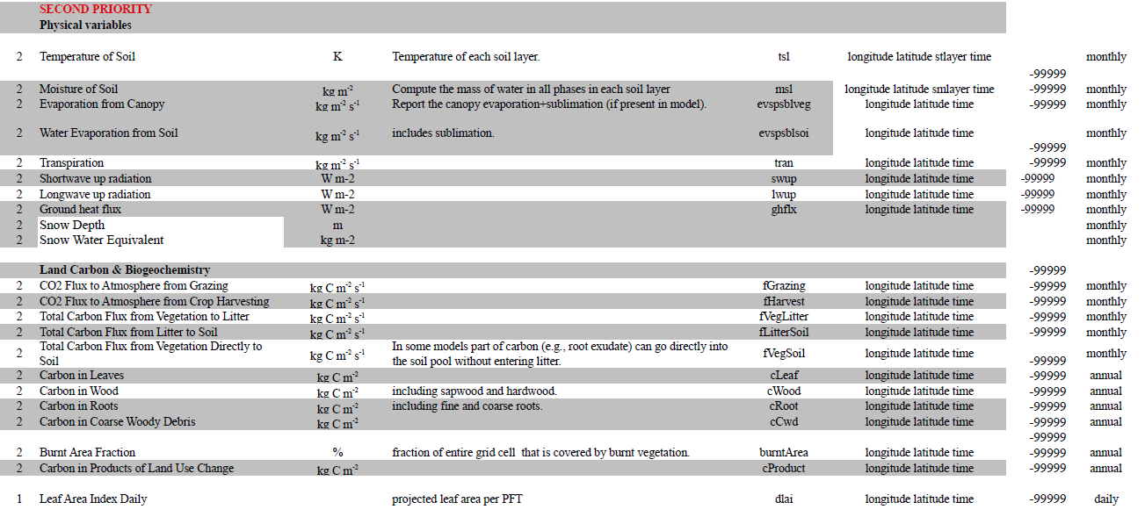
8.Outputs for TRENDY

